Slide 1
Good morning, I’m here as Coordinator of the Center for Prevention Evaluation and Statistics. Under the leadership of Jane Ungemack, and with a stellar team, we serve the DMHAS PHP data and evaluation needs. This is our year in review, Ignite style.
It’s been a busy year!

Slide 2
2020, it was the year of COVID, and more. With our strategic plan as rudder, CPES, like all of you, navigated the shift to social distance, telework, virtual prevention, and re-defining the work-life balance.

Slide 3
Just days after our DMHAS site visit, we shifted abruptly to the work from home model. Puzzling through Zoom and Teams, mute and unmute, screen sharing, and the dreaded echo, we learned quickly how to stay connected.

Slide 4
Collaboration with our partners was crucial. While we worked in isolation, we did not work alone, but as connected elements of CT’s prevention infrastructure. Together, we compiled and interpreted data, convened workgroups, evaluated efforts, and supported prevention.

Slide 5
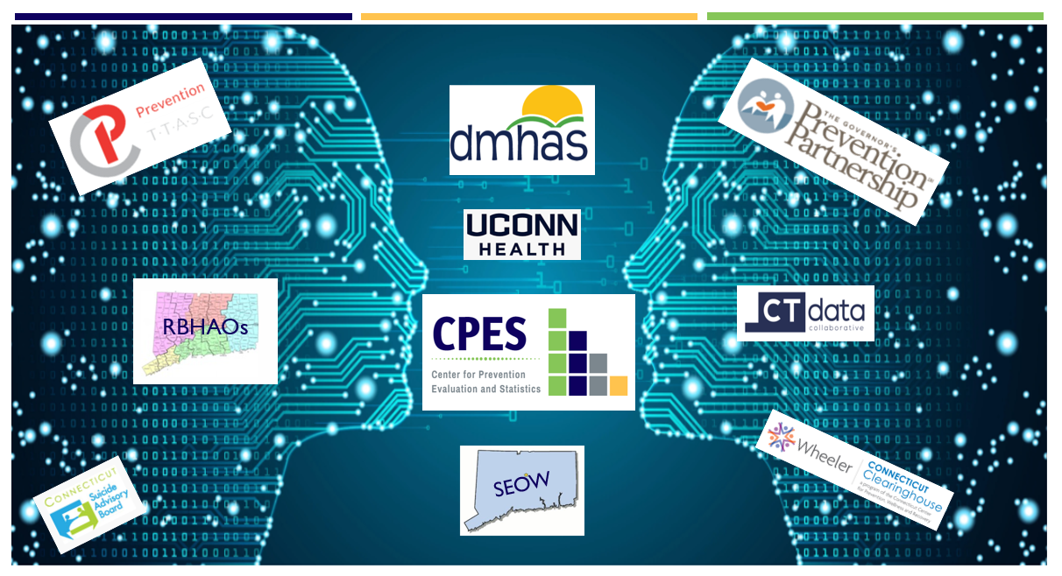
Our SEOW embodied collaboration. And with RBHAO outreach, we conducted the Community Readiness and Young Adult Surveys. We provided coalition support with TTASC, explored evaluation with GPP, and evaluated Change the Script with the Clearinghouse.

Slide 6
Communication was the lifeline of that work, and despite the “distance,” we met in each others’ virtual spaces, sharing perspectives, and making plans. We made new connections as well.
Adaptability is amazing, isn’t it?

Slide 7
The SEOW Prevention Data Portal remained our keystone,
a center for prevention data, visualizations, and products.
We pushed forward, despite challenges that delayed updates and enhancements.

Slide 8
We updated and expanded our Indicator dashboard, and developed data products. We accepted your generous feedback, and applied it, with the ongoing goal to maximize usefulness and usability for our end users.

Slide 9
With SEOW guidance, we published updated state Epidemiological Profiles across substances, and worked on mental health, suicide and problem gambling profiles, too, coming soon.

Slide 10
And we launched abridged Regional Data Stories, interactive visualizations with regional demographics, behavioral health, and school data, as a model for expansion.

Slide 11
We are particularly excited about these tools. Once expanded, data stories, and a linked, interactive dashboard, will provide crucial support the RBHAOs, DMHAS, and prevention partners at all levels.

Slide 12
For our SEOW, a quick pivot to a virtual meeting format yielded positive results, enhancing participation (33%), and bringing new members to the table. The SEOW successfully completed their data driven substance prioritization process to inform state planning.

Slide 13
To guide DMHAS’ regional planning process, we re-tooled the DMHAS guidance document. We then turned our attention to developing customizable regional epi profile templates, a data workbook, and companion data, to support this process.

Slide 14
Our Local Evaluator Workgroup (LEW) offered crucial peer support during COVID, and guided community coalitions in COVID-responsive data collection and survey practices. Their expertise was integral to the success of the PFS Virtual Focus Group initiative.

Slide 15
The SOR-funded evaluation of Change the Script assessed reach, satisfaction, and behavior change through stakeholder and consumer surveys, and process evaluation, all of this in collaboration with the CT Clearinghouse.

Slide 16
We also collected data. The Young Adults Statewide Survey (YASS) assessed behavioral health and COVID impacts among CT’s 18-25 year olds. Through FaceBook ads and partner outreach, we garnered over 1200 responses, addressed a data gap, and gained insight into the experience of CT’s young adults.

Slide 17
And of course our biennial key informant Community Readiness Survey, expanded to assess mental health, suicide and problem gambling. 2020 was largest response ever, with the most complete statewide coverage, thanks to our RBHAO partners.

Slide 18
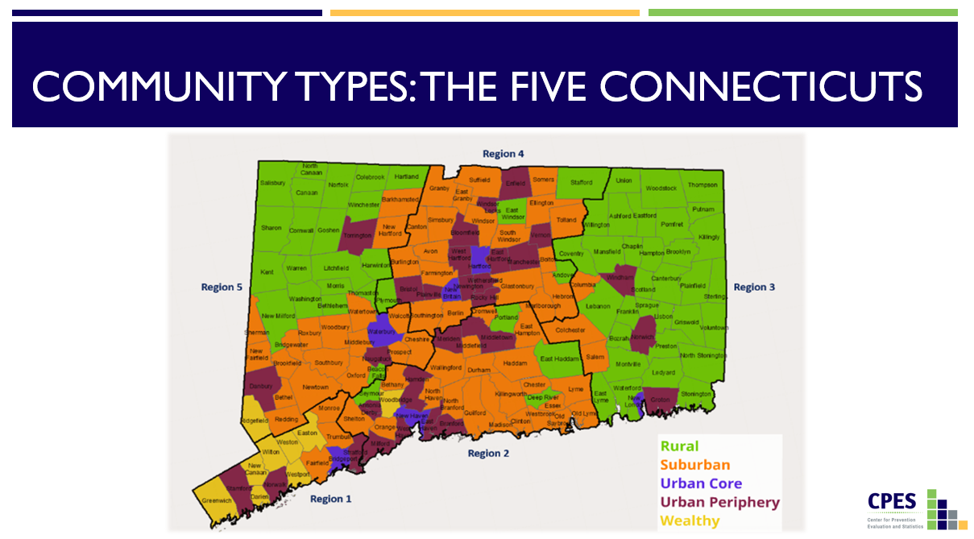
With health equity and social justice as touchpoints, we honed our data focus. Taking our cues from our partners, we began to examine CRS and other data through this lens, and applied the 5 Connecticuts to our sampling and data collection.

Slide 19
We grew as a team, and honed our plans for 2021. Among them:
Broaden the SEOW focus to address mental health and ACES, health disparities and equity;
Enhance local data availability and capacity;
Empower and expand the LEW;
and plan for the CRS 2022.

Slide 20
Yes, it’s been a busy year, productive and formative. We are proud of ourselves and our partners, our partnership. And we’re excited for the important work to come, in collaboration with you all.

